Slide 1
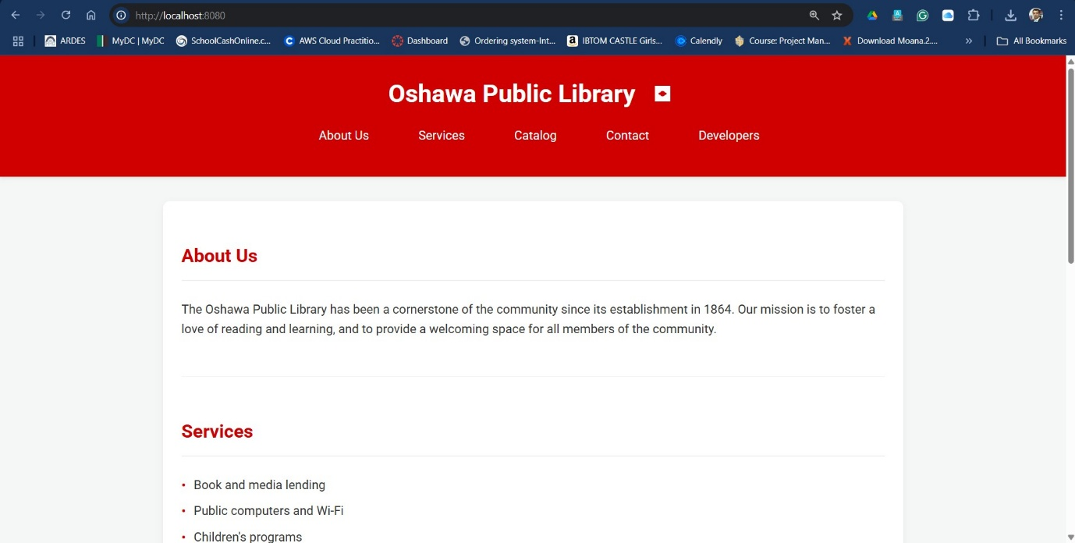
Deploying a Containerized Static Website on AWS ECS with CI/CD
This project involves deploying a static website for the Oshawa Public Library using a fully containerized and cloud-native architecture.
The goal was to implement a scalable, secure, and automated hosting solution leveraging core AWS services such as ECS Fargate, ECR, VPC, and GitHub Actions for CI/CD.
The deployment follows a professional infrastructure setup, ensuring future readiness for backend integration and minimizing operational overhead through automation.
Presented by : Group 1 Anju (100959389)
Muskaan Fatima (101005853)
Hushang Fikrat Muhibullah (101012042)
Mohammad Kaif (101001476)
By Group 1

Slide 2

Team Roles
Anju : Architecture Diagram , Flow Chart design for All the Process.
Muskaan Fatima : Cloud Networking(VPC, Subnets, Route Tables)
Hushang Fikrat Muhibullah : Website creation, Docker and running building image, ECR and CI/CD Pipeline.
Mohammad Kaif: ECS Cluster, ECS Task Definition andECS Service.
By Group 1

Slide 3
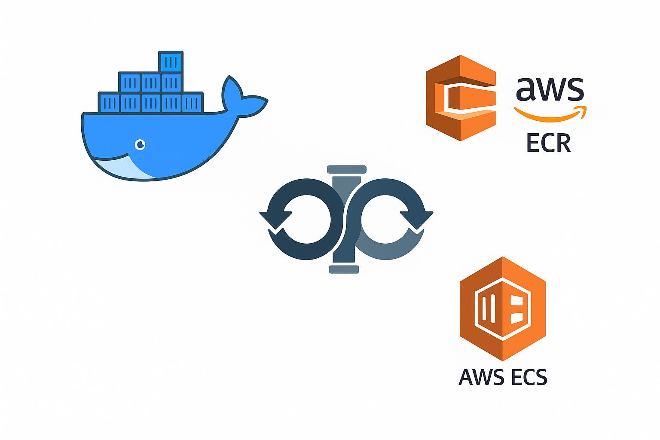
Objective and Scope
Objective: To design and deploy a fully containerized static website on AWS for the Oshawa Public Library using CI/CD pipelines and secure cloud infrastructure.
Scope:
Build and test application locally using Docker
Automate image push and deployment via GitHub Actions
Use AWS ECR to store container images
Host app on AWS ECS (Fargate) within a public subnet
Configure VPC with public/private subnets, IGW, and NAT Gateway
Reserve private subnet for future backend integration
Secure all resources via IAM and Security Groups
By Group 1

Slide 4
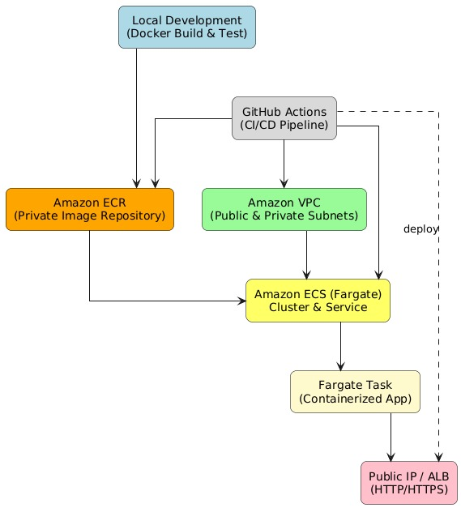
Flow Chart: Deployment Workflow
Deploy to ECS
By Group 1

Slide 5

Flow Chart: Service Integration
Local Development: Application was built and tested using Docker to ensure functionality before cloud deployment.
Manual Image Push: The Docker image was initially pushed to Amazon ECR using the AWS CLI.
Amazon ECR: Stores versioned Docker images in a secure private repository.
Amazon VPC: Defines network isolation using public/private subnets and security groups.
Amazon ECS (Fargate): Pulls container images from ECR and deploys the app without managing infrastructure.
GitHub Actions (CI/CD Pipeline): Automates future builds, pushes, and Fargate task deployments upon code commits.
Public Access: The deployed app is accessible via public IP/ALB with routing handled securely through the VPC.
By Group 1

Slide 6
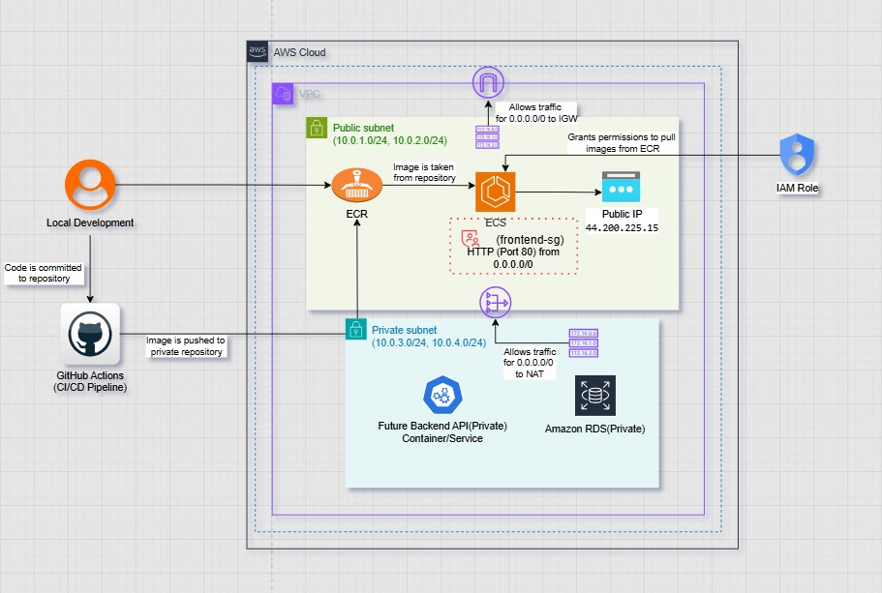
Architecture Diagram: Overview
By Group 1

Slide 7
Architecture Diagram: Network & Data Flow
Local Development → GitHub Actions: Developers commit code, triggering the CI/CD pipeline to build and test a Docker image.
GitHub Actions → ECR: The built image is pushed to a private Amazon ECR repository.
ECS in Public Subnet: Amazon ECS (Fargate) service pulls the image from ECR and runs the containerized frontend application with a public IP via the Internet Gateway (IGW).
Private Subnet: Currently reserved for future backend API services and Amazon RDS (database) as part of future enhancements. Outbound internet access is provided through a NAT Gateway for updates and dependencies.
Security Controls:
SG (Security Group): Virtual firewall for AWS resources, controlling inbound and outbound traffic.
Frontend SG: Allows HTTP/HTTPS from the internet.
Backend SG: Allows traffic only from the frontend SG.
Route tables direct public subnet traffic to IGW and private subnet traffic to NAT Gateway.
Traffic Flow:
Public clients → ECS frontend (HTTP/HTTPS, public IP).
ECS frontend ↔ Backend API (private VPC communication).
Outcome: This design ensures secure isolation between public and private components, supports least-privilege access, and is ready for future backend and database integration.
By Group 1

Slide 8
VPC Configuration
This VPC (10.0.0.0/16) is designed for a two-tier architecture, separating public-facing resources from private ones for security and scalability.
Subnets:
Public: 10.0.1.0/24 (us-east-1a), 10.0.2.0/24 (us-east-1b) – host internet-accessible services (ECS frontend).
Private: 10.0.3.0/24 (us-east-1a), 10.0.4.0/24 (us-east-1b) – reserved for backend/API and future RDS.
Routing:
Public Route Table: Internet via IGW.
Private Route Table: Outbound internet via NAT Gateway.
Network Components:
Internet Gateway: For public subnet access.
NAT Gateway: For private subnet outbound traffic without exposing them directly to the internet.
Key Point: This setup ensures public services are reachable while backend components remain isolated inside private subnets.
By Group 1

Slide 9
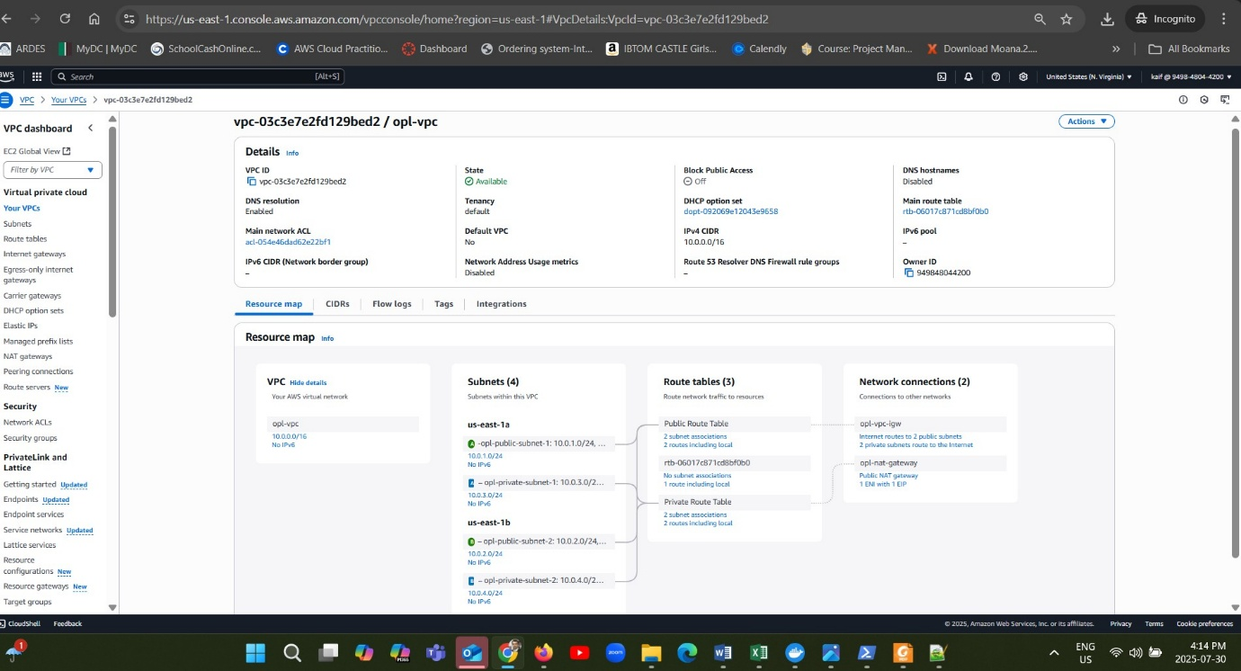
VPC Configuration
By Group 1

Slide 10
Subnet Design
The VPC is divided into 4 subnets across two Availability Zones (us-east-1a and us-east-1b) for high availability and fault tolerance.
Public Subnets:
10.0.1.0/24 (us-east-1a)
10.0.2.0/24 (us-east-1b)
Used for hosting internet-facing services like ECS frontend tasks.
Private Subnets:
10.0.3.0/24 (us-east-1a)
10.0.4.0/24 (us-east-1b)
Reserved for backend services and future RDS database, isolated from direct internet access.
Key Point: By distributing public and private subnets across two Availability Zones, the architecture ensures resilience, load balancing capability, and secure separation of components.
By Group 1

Slide 11
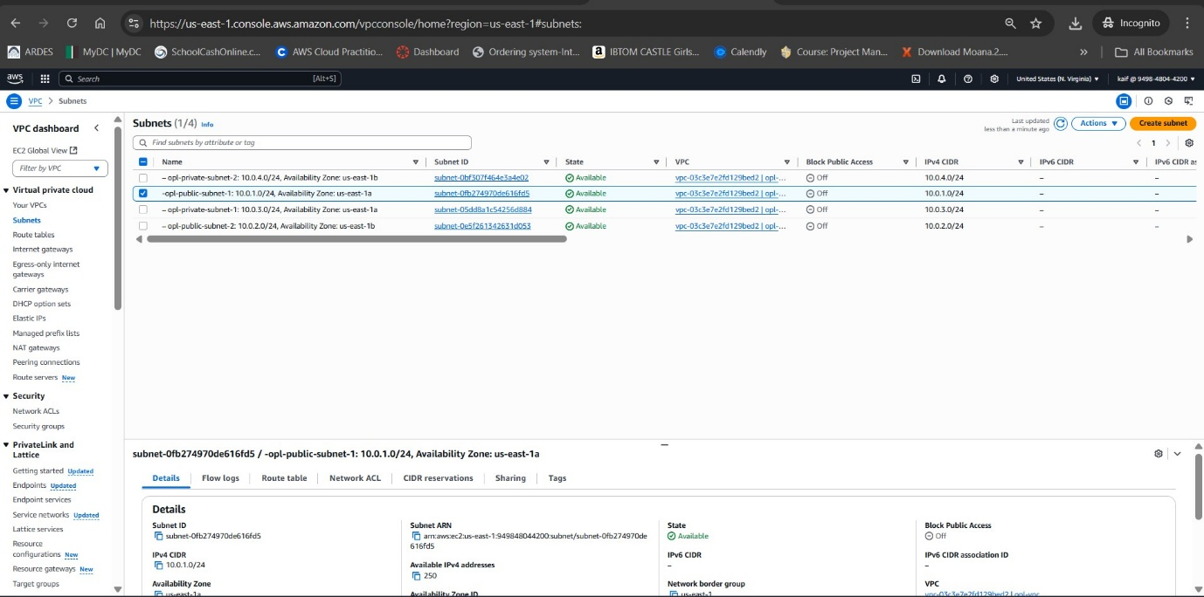
Subnet
By Group 1

Slide 12
Internet Gateway & NAT Gateway Configuration
1. Internet Gateway (IGW)
Purpose: Enables public subnets to communicate with the internet, handling inbound and outbound traffic.
Name: opl-vpc-igw
State: Attached to our VPC vpc-03c3e7e2fd129bed2
Use Case: Public-facing services like ECS frontend tasks.
2. NAT Gateway
Purpose: Allows instances in private subnets to access the internet without exposing them to inbound traffic.
Name: opl-nat-gateway
Public IP: 18.214.206.231
Subnet Location: Public subnet 10.0.1.0/24 (us-east-1a)
Use Case: Backend services and future RDS for updates & dependencies.
Key Point: The IGW connects public resources to the internet, while the NAT Gateway securely routes outbound traffic from private resources — together ensuring a secure and functional hybrid network setup.
By Group 1

Slide 13
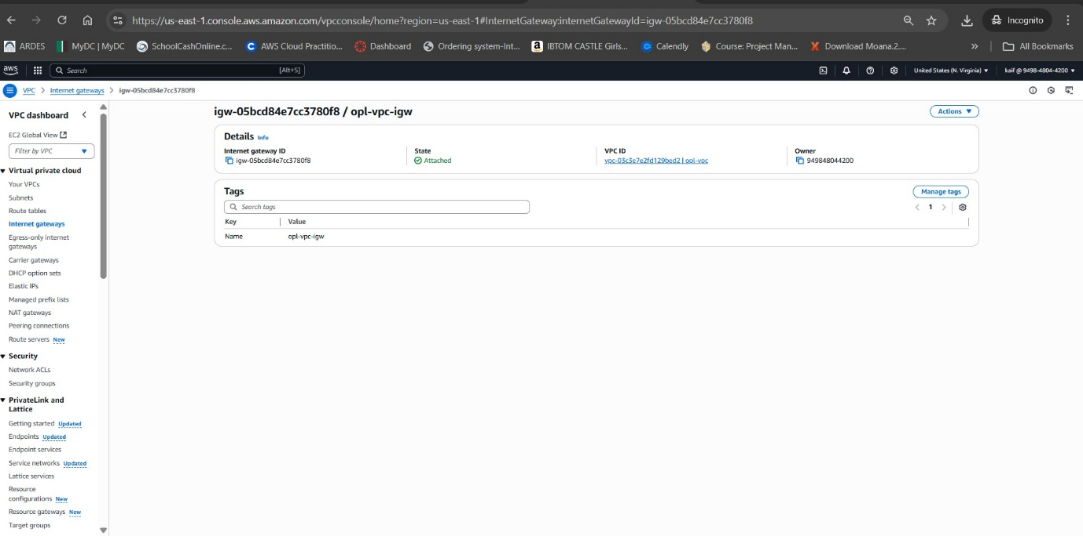
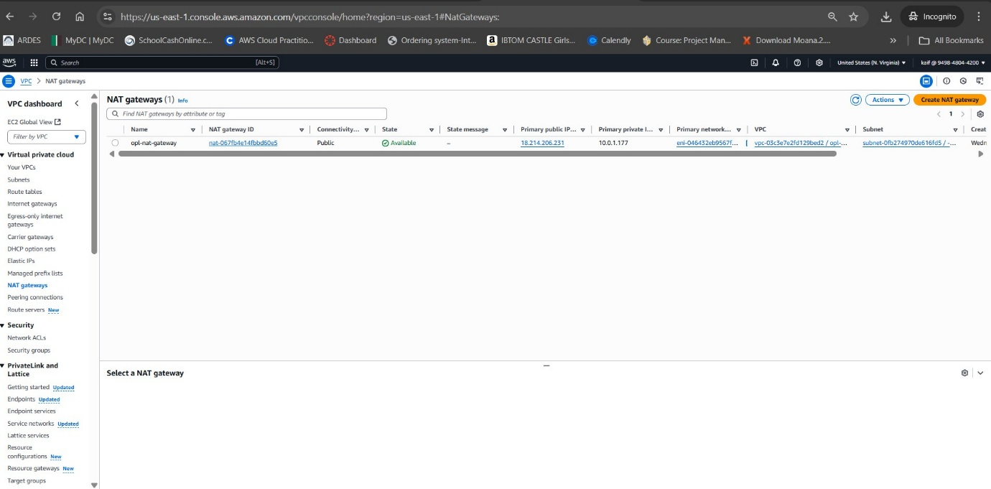
Internet Gateway & NAT Gateway

Slide 14
Route Table Configuration
1. Public Route Table
Name/ID: rtb-0e6b3d5658846ae4e
Associated Subnets: 2 Public Subnets (10.0.1.0/24, 10.0.2.0/24)
Routes:
0.0.0.0/0 → Internet Gateway (igw-05bcd84e7cc3780f8) – allows internet access.
10.0.0.0/16 → local – internal VPC communication.
2. Private Route Table
Name/ID: rtb-04dab8ea074016293
Associated Subnets: 2 Private Subnets (10.0.3.0/24, 10.0.4.0/24)
Routes:
0.0.0.0/0 → NAT Gateway (nat-0ade9592006b855ca) – outbound internet via NAT.
10.0.0.0/16 → local – internal VPC communication.
Key Point: The Public Route Table enables internet-facing services, while the Private Route Table allows secure outbound connectivity from private resources without exposing them directly to the internet.
By Group 1

Slide 15
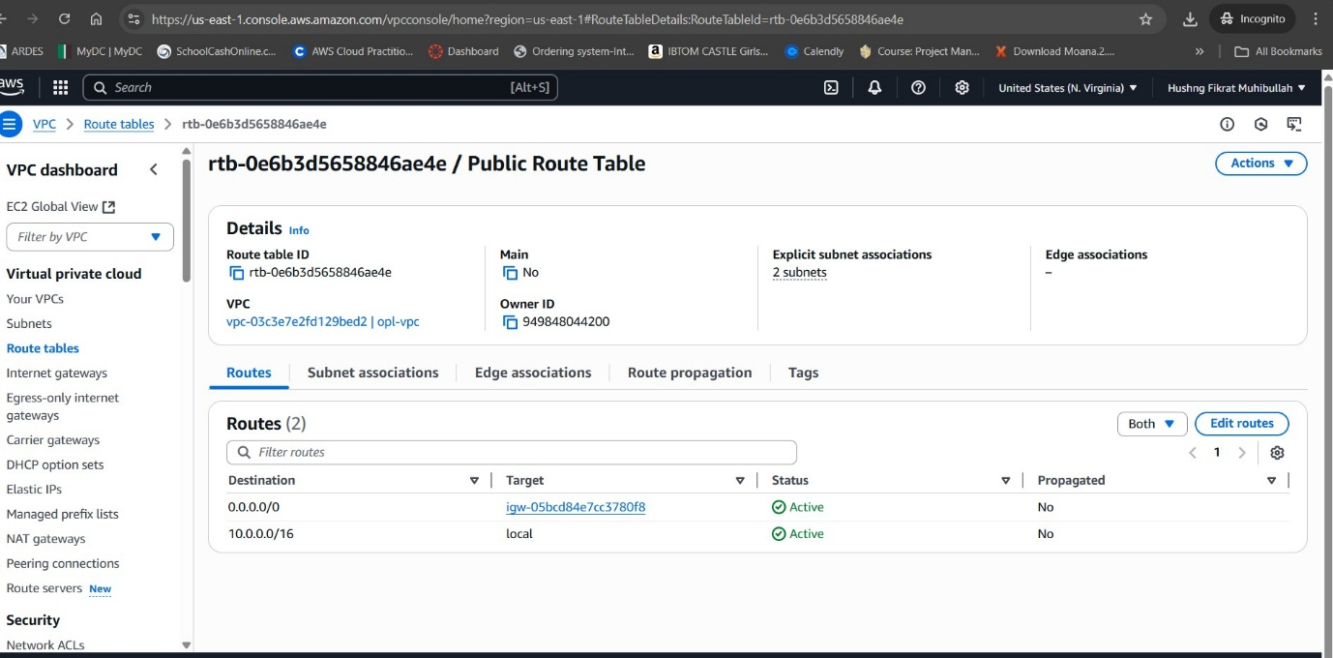
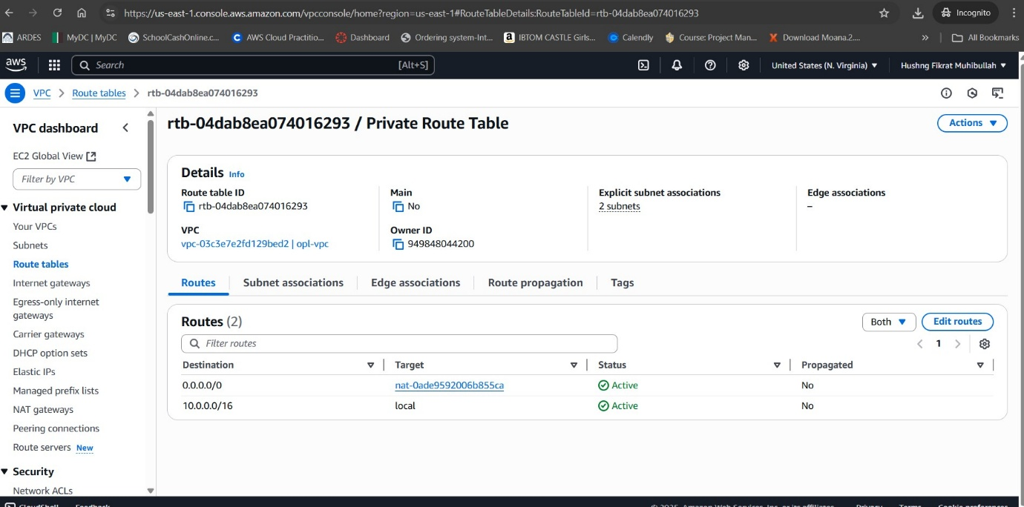
Route Tables

Slide 16
Security Group Configuration
1. Frontend Security Group (frontend-sg)
Purpose: Allows public HTTP access to the ECS frontend service.
Inbound Rule:
Type: HTTP (TCP, Port 80)
Source: 0.0.0.0/0 (open to the internet)
Outbound Rule: Allows all outbound traffic (default).
Use Case: Ensures users can access the frontend application via a web browser.
2. Backend & Database Security Groups (Future Expansion)
Purpose: Secure private services like backend APIs and databases.
Rules (planned):
Allow traffic only from specific internal sources (e.g., frontend SG).
Block all direct public access.
Use Case: Keeps sensitive services isolated, ensuring only trusted internal communication within the VPC.
Key Point: Security Groups act as virtual firewalls, controlling both inbound and outbound traffic at the resource level. This separation between public and private layers ensures least-privilege access and enhances security.
By Group 1

Slide 17
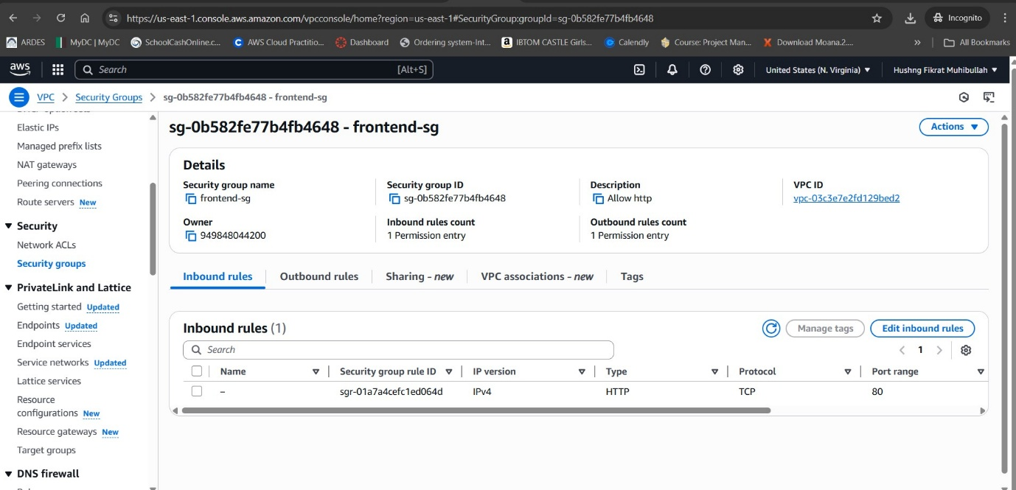
Security Group
By Group 1

Slide 18
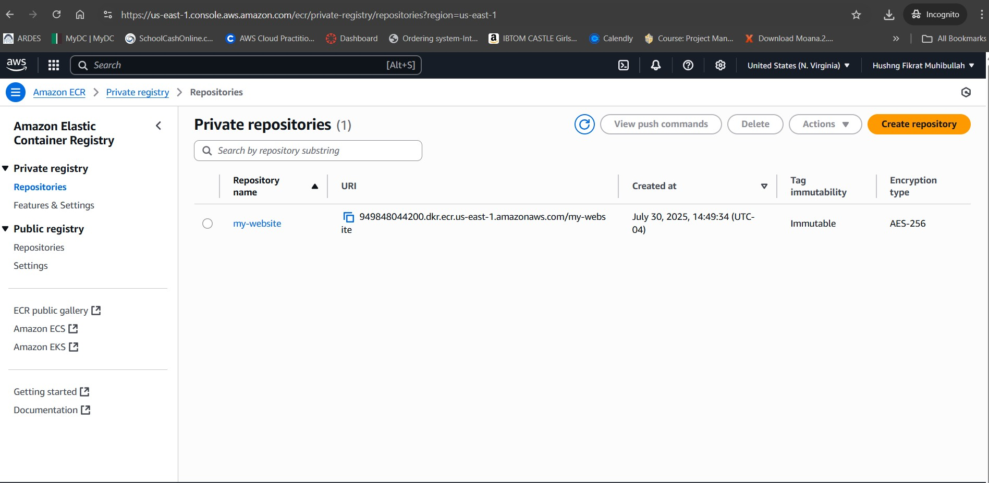
By Group 1

Slide 19
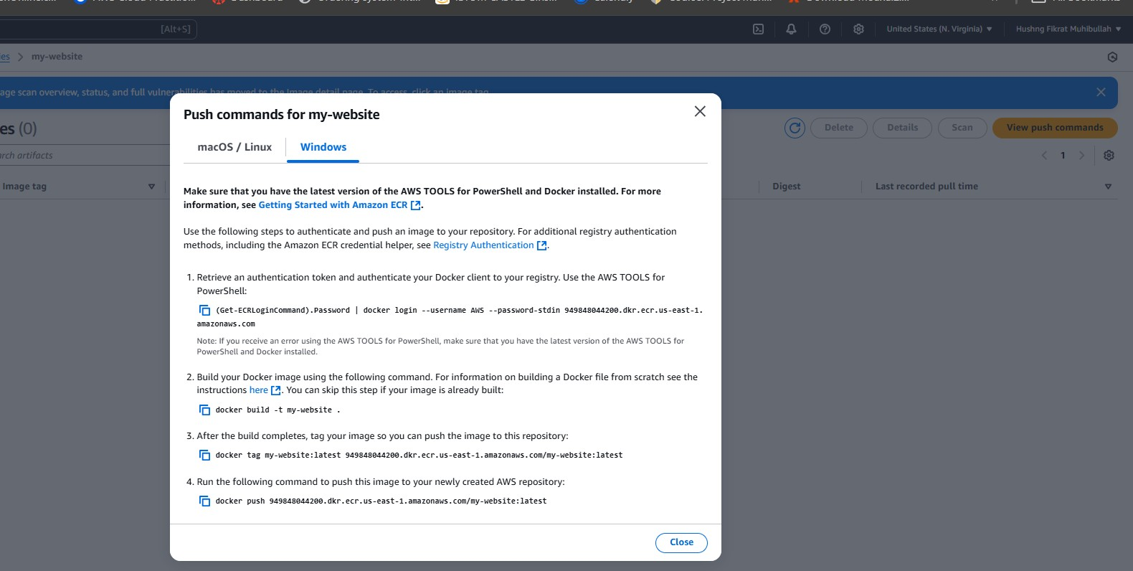
4 steps of creating Repo, Building docker image,
tag image, push image to AWS repository
By Group 1

Slide 20
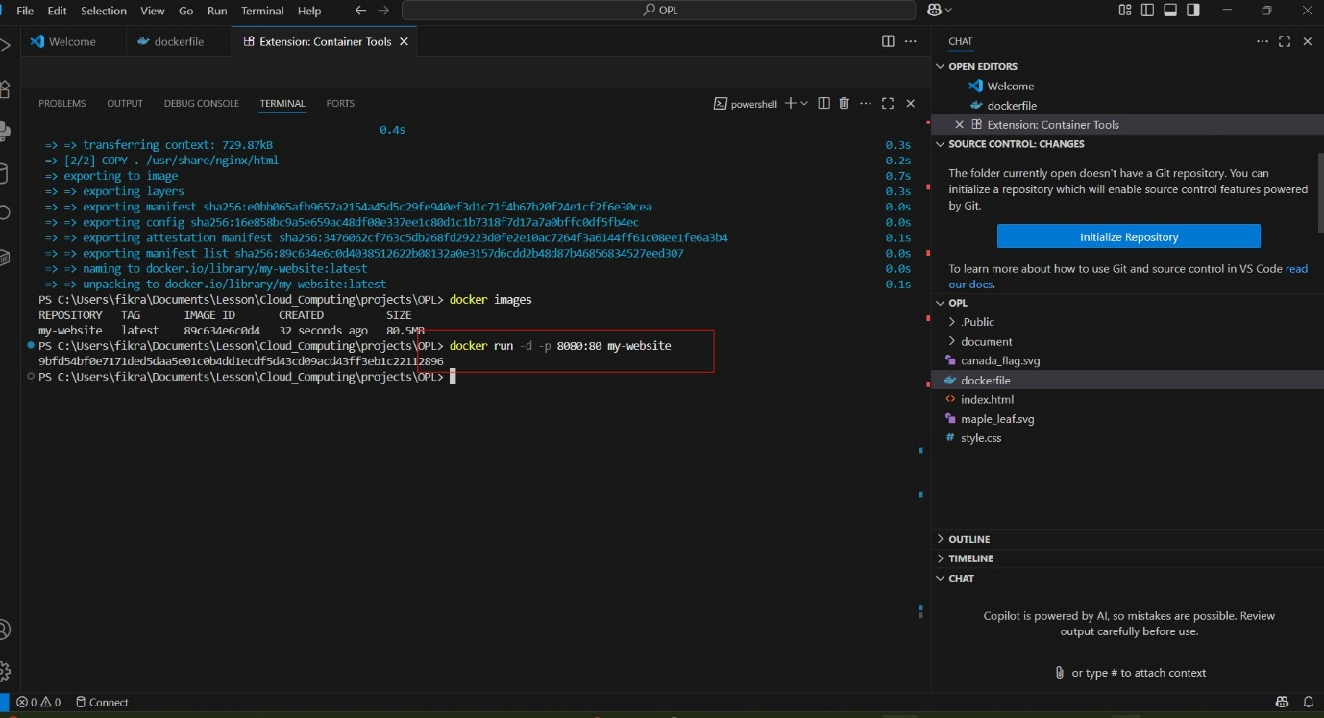
Docker Installation & Local Testing
• Installed Docker on the local machine to enable containerization of the OPL web application.
• Built the Docker image locally and ran it to confirm proper functionality.
• The OPL website was successfully hosted locally.
By Group 1

Slide 21
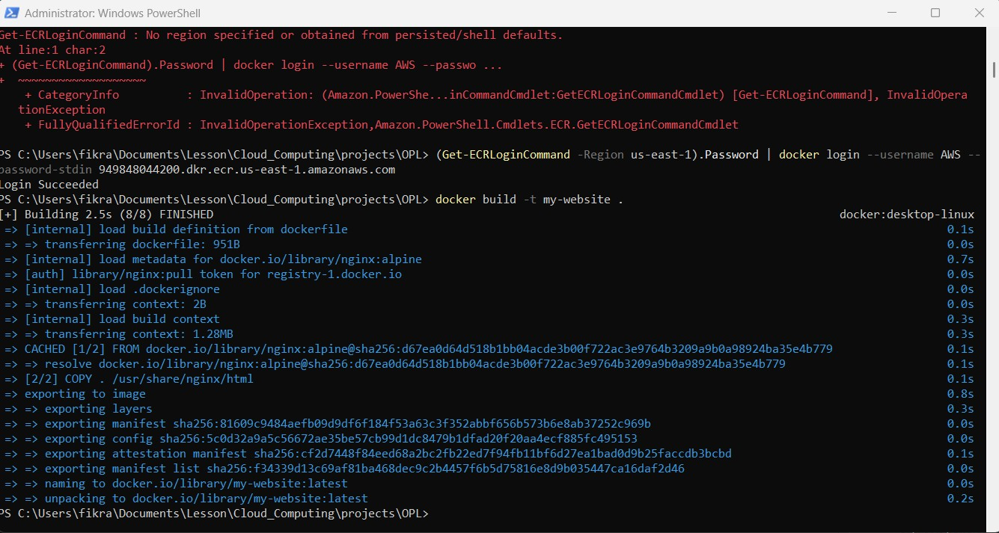
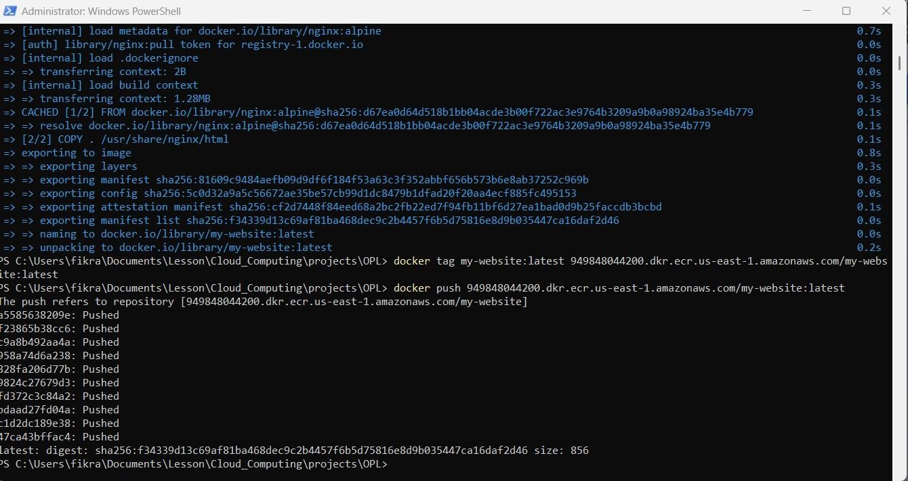
Push the local Docker image to AWS ECR

Slide 22

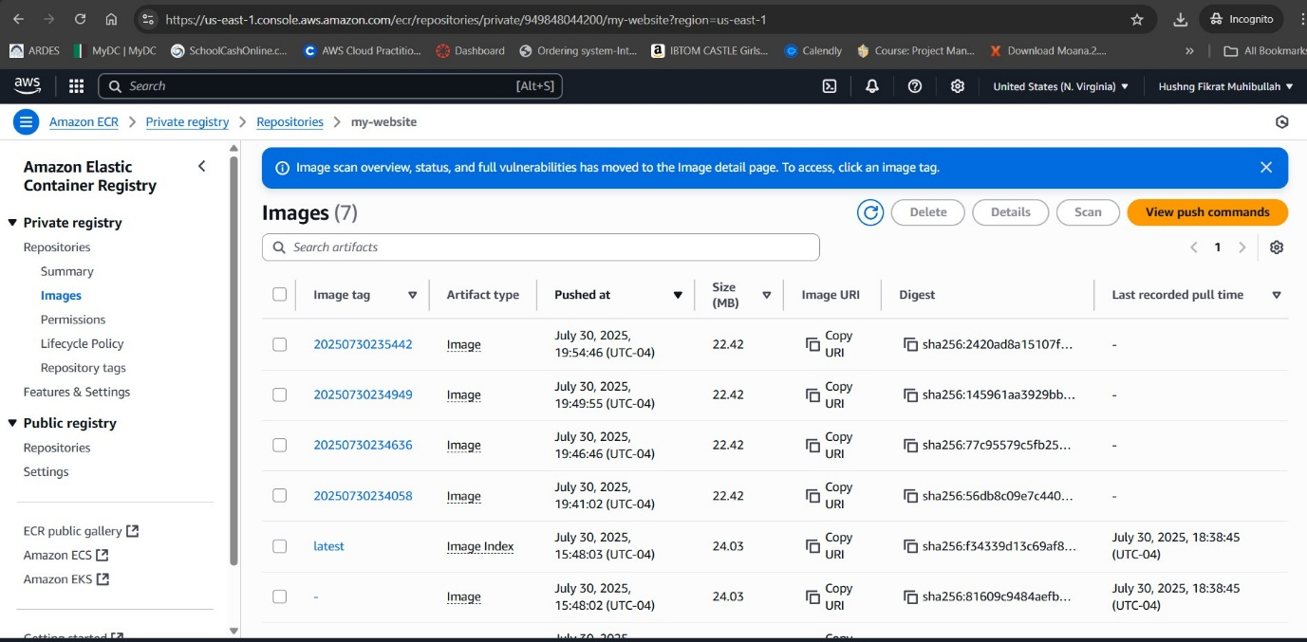
AWS ECR – Docker Image pushed

Slide 23
Amazon Elastic Container Registry (ECR) – Web App Repository
Purpose: Amazon ECR is a fully managed Docker container registry for storing, managing, and deploying container images securely.
Repository Details:
Name: my-website
URI: 949848044200.dkr.ecr.us-east-1.amazonaws.com/my-website
Encryption: AES-256 (secure at rest)
Tag Immutability: Enabled (prevents overwriting image tags).
Web App Deployment:
We manually uploaded the Docker image of our website using ECR push commands for Windows.
The image contains our complete web application and its dependencies.
Multiple image versions are stored, tagged with timestamps and latest for easy updates.
Benefits:
Centralized, secure storage for container images.
Integrated with AWS IAM for fine-grained access control.
Ensures version control and rollback capability for deployments.
Key Point: ECR serves as the source of truth for ECS deployments — ECS (Fargate) pulls the image directly from ECR to run the web app.
By Group 1

Slide 24
Amazon ECS (Elastic Container Service) with Fargate
Cluster Creation:
Task Definition:
Set up ECS cluster using Fargate launch type (serverless container hosting).
Network: VPC 10.0.0.0/16 with 2 public + 2 private subnets across AZs.
Defined container image from ECR.
Allocated CPU/memory resources.
Configured networking to connect with the public subnet and security group.
IAM: Task role + Execution role (pull from ECR, send logs).
Service Creation:
Scaling & Management:
Purpose: Keeps desired tasks running (our desired count = 1).
Placement: Public subnets, Assign public IP = Enabled.
Security: frontend-sg allows HTTP/80 from the internet.
Deploys: Rolling update when task definition revision change
ECS handles task orchestration, scaling, and health checks automatically.
By Group 1

Slide 25
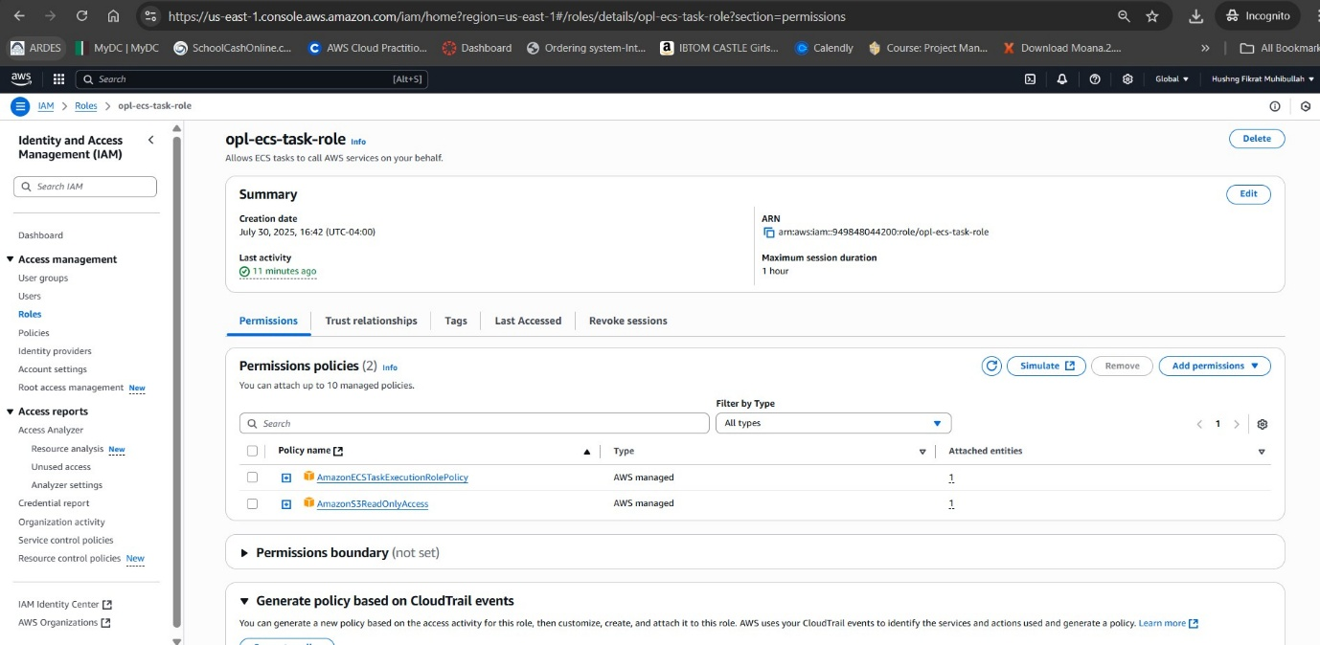
IAM Role for ECS Tasks — opl-ecs-task-role
Purpose: Execution role used by ECS tasks to access AWS services securely (least-privilege).
Attached Policies:
AmazonECSTaskExecutionRolePolicy – lets tasks pull images from Amazon ECR and write logs to CloudWatch Logs.
AmazonS3ReadOnlyAccess – (optional) allows read-only access to S3 objects.
Outcome: Enables tasks to start successfully (image pull + logging) while maintaining tight access controls.
By Group 1

Slide 26
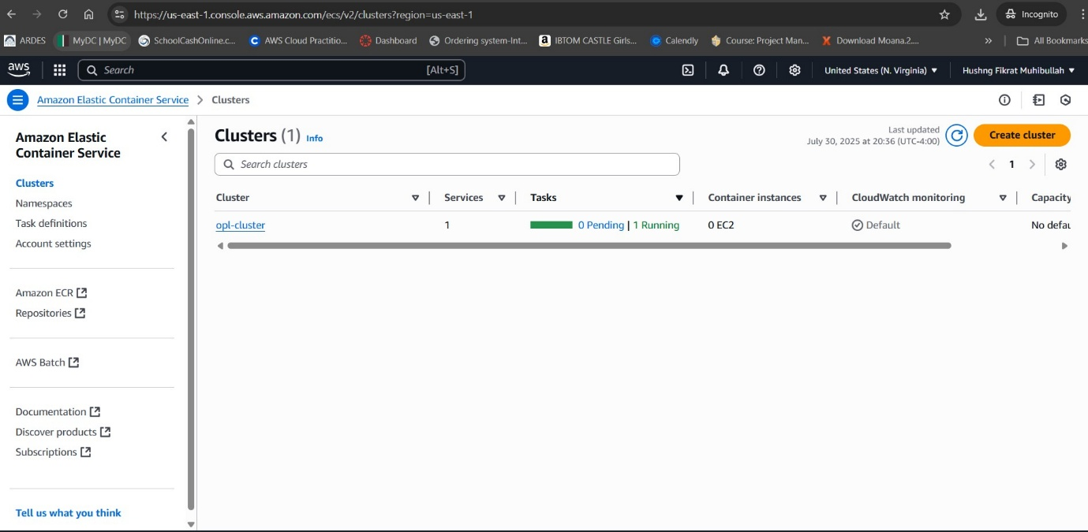
ECS Cluster
By Group 1

Slide 27
ECS Cluster – Overview & Purpose
What is an ECS Cluster?
A logical grouping of ECS resources where your tasks and services run.
In Fargate mode (our setup), AWS manages all servers — the cluster is serverless.
Acts as the environment for deploying and managing containerized applications.
Cluster in This Project:
Name: opl-cluster
Launch Type: Fargate (serverless, no EC2 instances)
Services Running: 1
Tasks Running: 1 active task (your website container)
Purpose in Deployment:
Hosts and runs the ECS service for the web application.
Monitors task status (Running / Pending).
Enables scaling by adding more tasks or services.
KeyPoint: The ECS Cluster is like the control room where AWS organizes and monitors your running containers, ensuring high availability and easy scalability.
By Group 1

Slide 28
ECS Task Definition
Definition:
A blueprint for running containers in Amazon ECS.
Tells ECS what to run, how to run it, and where to get the image.
Key Components:
Container Image: Location in ECR or another registry.
CPU & Memory: Resource allocation per container.
Networking Mode: How the task connects (public/private).
Ports & Env Variables: Application-specific settings.
IAM Roles: Permissions for the container.
Purpose in This Project:
Defines how the website container is deployed in ECS.
Ensures consistency across deployments.
Forms the base for ECS Services to create and maintain running tasks.
By Group 1

Slide 29
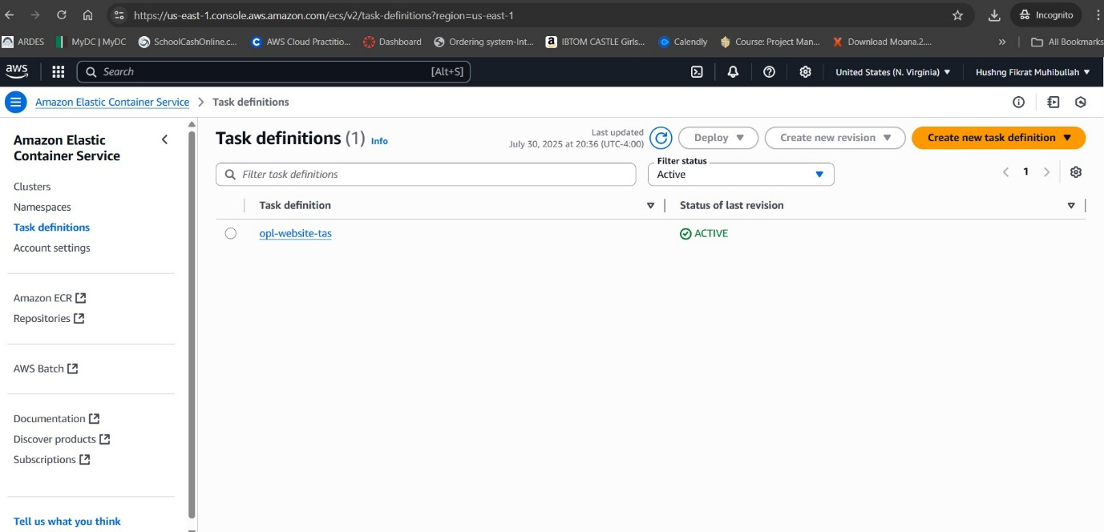
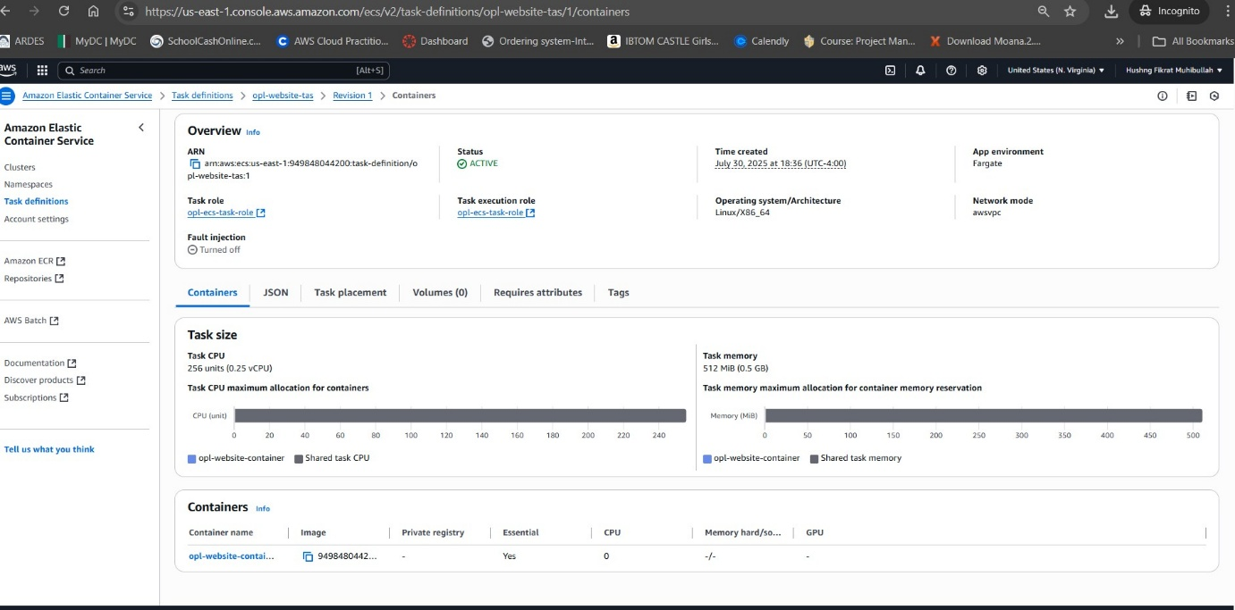
Created ECS Task Definitions
By Group 1

Slide 30
Task Definitions Details
Task Definition List
Created ECS task definitions.
Active definition: opl-website-tas (status: Active).
Task Definition Details
Task Size: 256 CPU units (0.25 vCPU), 512 MB memory.
Container Name: opl-website-container.
Image Source: Pulled from private ECR repository (my-website).
Network Mode: awsvpc – task gets its own ENI & private IP.
Essential Container: Yes – must run for the task to be healthy.
Key Point: The task definition is the bridge between your container image in ECR and your running application in ECS.
By Group 1

Slide 31
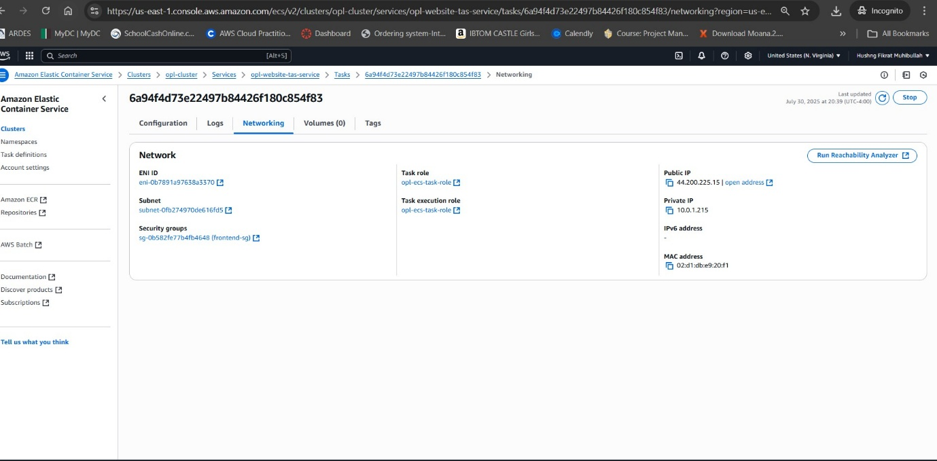
ECS Service & Task Networking
By Group 1

Slide 32
ECS Service and Task Networking Details
What is an ECS Service?
An ECS Service is a long-running task manager.
It launches tasks from a task definition and ensures the desired number of tasks are always running.
If a task fails, the service automatically replaces it.
Can be scaled to run multiple tasks and linked with a load balancer for high availability.
Networking Details:
ENI ID: eni-078b191759a833170 – Elastic Network Interface for the task.
Subnet: 10.0.1.0/24 (Public Subnet) – allows public access.
Security Group: frontend-sg – allows HTTP traffic (Port 80) from the internet.
Task Role / Execution Role: Permissions for pulling images from ECR and logging to CloudWatch.
Public IP: 44.200.225.15 – end-user access point.
Private IP: 10.0.1.215 – for internal VPC communication.
MAC Address: Hardware address of the ENI.
Purpose:
The ECS Service ensures continuous availability of the web application.
Networking settings allow public HTTP access while maintaining internal connectivity for future backend integration.
By Group 1

Slide 33
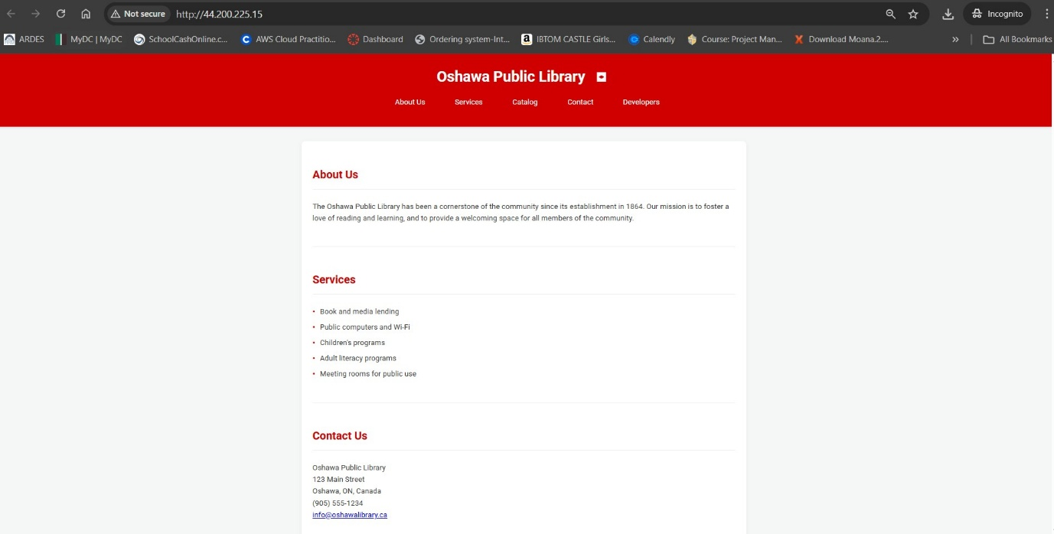
Successful deployment of a static website hosted on AWS infrastructure. The public IP address (44.200.225.15) is accessible in the browser, serving the Oshawa Public Library website. This result proves that the ECS is correctly set up in a public subnet with the right security group and routing. It’s the final verification that all cloud networking and containerization steps were done properly.
By Group 1

Slide 34
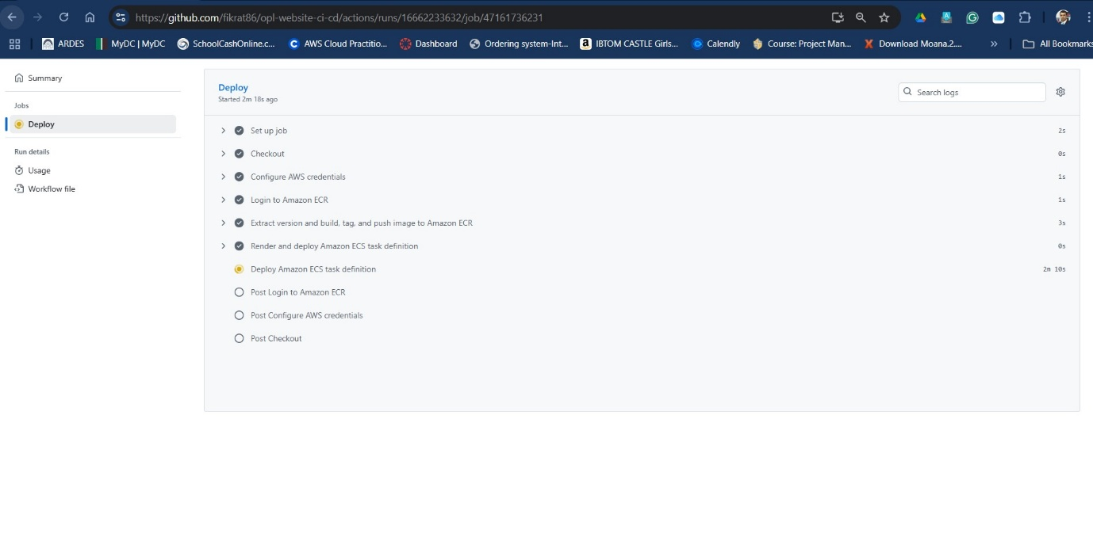
GitHub Actions CI/CD – Deploy Pipeline
By Group 1

Slide 35
GitHub Actions CI/CD – Deploy Pipeline
Purpose: Automate build → image push → ECS deploy whenever code is updated.
What this run did:
Set up job & Checkout – Runner starts and pulls repo code.
Configure AWS Credentials – Uses GitHub Secrets (AWS_ACCESS_KEY_ID / AWS_SECRET_ACCESS_KEY / REGION).
Login to Amazon ECR – Authenticates the runner to our private ECR.
Build, Tag, and Push Image – Docker builds the website image, tags it (:latest + commit/tag), and pushes to ECR
Render & Deploy ECS Task Definition – Substitutes the new ECR image URI into the task definition JSON.
Deploy Amazon ECS Task Definition – Updates the ECS Service; ECS pulls the new image and starts a new task (rolling update).
Post steps – Logout/cleanup.
Outcome:
New Docker image stored in ECR.
ECS Service updated to the new revision, keeping the site available (no manual steps).
By Group 1

Slide 36
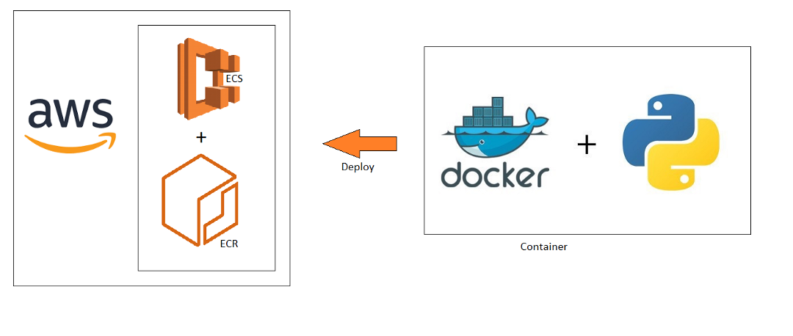
Conclusion
Our team successfully delivered a secure, scalable, and automated deployment of the Oshawa Public Library’s static website.
The two-tier VPC design with public and private subnets sets a strong foundation for future backend and database services.
Through the integration of GitHub Actions, ECS Fargate, and ECR, we eliminated manual intervention and ensured high availability.
This project enhanced our understanding of real-world AWS deployment.
By Group 1

